Slide 1

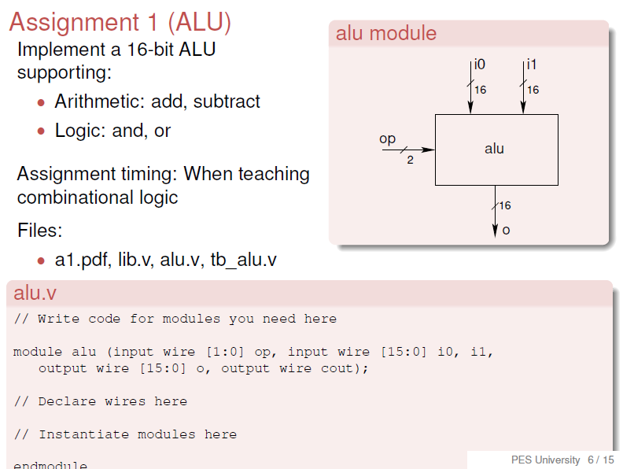
Arithmetic Logic Unit
Aim of the Experiment: Implement a
16 bit ALU
supporting:
Arithmetic operations :
add, subtract
Logic operations :
and, or

Slide 2
The ALU (Arithmetic and Logic Unit) is the heart of a CPU since it
performs the arithmetic and logic operations which are the key computations.
Your task in this assignment is to design and simulate a 16-bit1 ALU which performs the following core operations
Arithmetic Addition and subtraction (two’s complement)
Logic AND along with OR operation
Each operation would receive as input two 16-bit operands and the output would be a 16-bit result (along with carry and overflow).
The decision on which of the four operations is to be performed would be indicated by a two bit operation input. So the ALU module inputs are:
• i0[15:0] 16-bit operand 0
• i1[15:0] 16-bit operand 1
• op[1:0] 2-bit operation code

Slide 3
Operation Code meaning
The ALU module outputs should be:
• o[15:0] 16-bit operation result
• carry Carry out of MSB
• overflow Arithmetic overflow
During logic operations the values of the carry and overflow outputs are irrelevant.
op[1:0] | operation
00 | Addition
01 | Subtraction
10 | and
11 | or

Slide 4
The ALU module inputs are:
i0[15:0] 16-bit operand i0 | i1[15:0] 16-bit operand i1
The opcode bits are op1,op0(2 bit operation code)
00 01 10 11 | add subtract and or
The ALU module outputs are:
o[15:0] 16-bit operation result
The status bits are
Carry Carry out of MSB | Overflow Arithmetic overflow

Slide 5
Once you have designed the ALU logic, it needs to be specified using the Verilog syntax .
The entire ALU should be composed of purely combinational logic elements that have been discussed in class.
Also, only the Verilog module definition and instantiation syntax discussed in class should be used.
Once the ALU is designed, it needs to be simulated to verify proper functionality of its various operations.
Appropriate inputs need to be applied to the ALU.

Slide 6
The inputs are specified as test vectors, four of which are specified as samples on lines 14 to 17 of tb_alu.v.
The samples test only the arithmetic functionality.
Additional test vectors need to be added not only for logic but arithmetic operations as well.
Be sure to change value of TESTVECS on line 2 whenever the number of test vectors is modified.

Slide 7
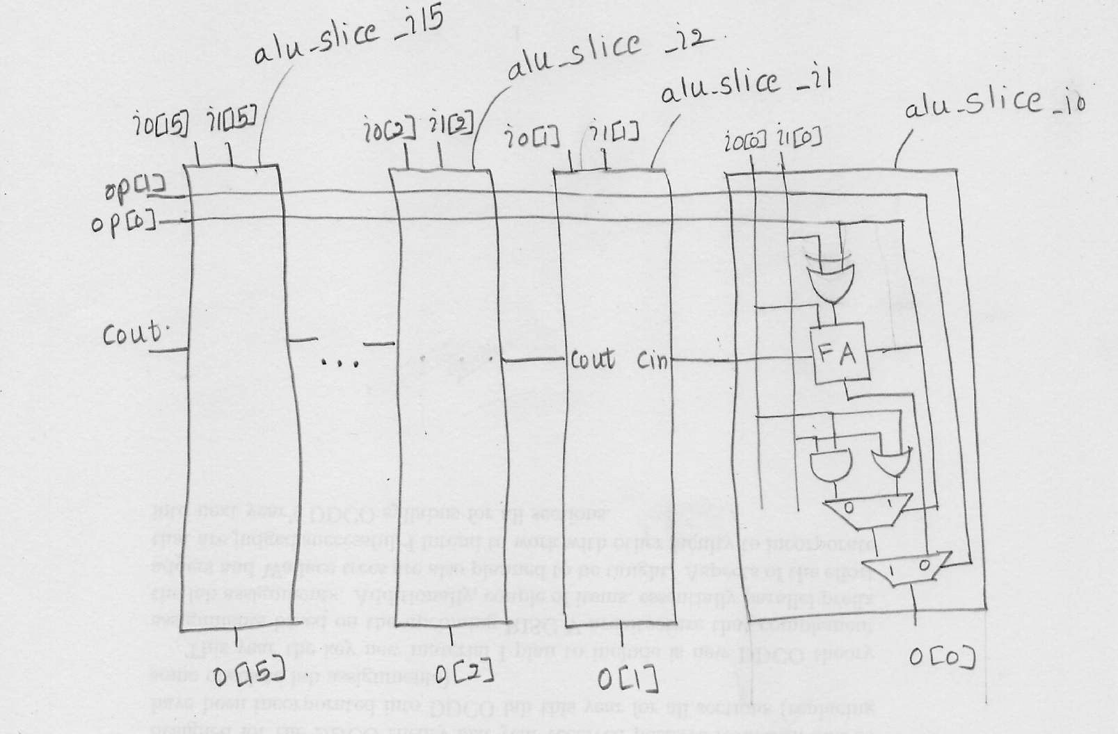

Slide 8
Source File alu.v
module fa (input wire i0, i1, cin, output wire sum, cout); wire t0, t1, t2;
xor3 _i0 (--------------------);
and2 _i1 (-------------------);
and2 _i2 (----------------);
and2 _i3 (---------------);
or3 _i4 (----------------);
endmodule
module addsub (input wire addsub, i0, i1, cin, output wire sumdiff, cout);
wire t;
fa _i0 (----------------------);
xor2 _i1 (-------------------------);endmodule
Notes:
Sum=i0 XOR i1 XOR cin
Cout=i0i1+i1cin+cini0
I0
I1, addsub,t

Slide 9
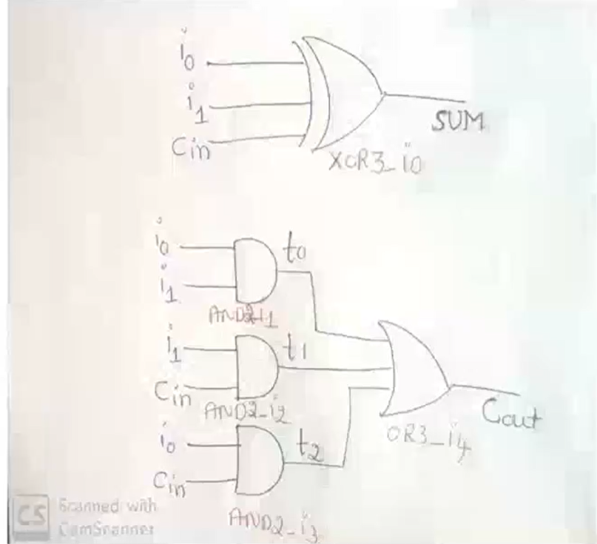

Slide 10
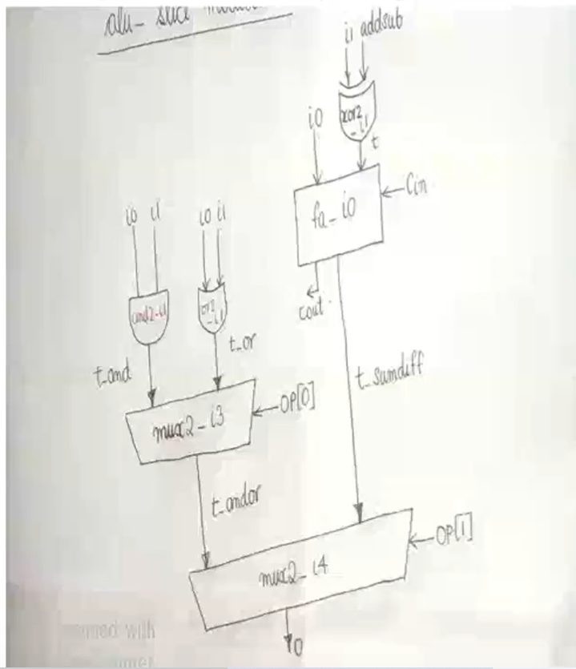

Slide 11
module alu_slice (input wire [1:0] op, input wire i0, i1, cin, output wire o, cout);
wire t_sumdiff, t_and, t_or, t_andor;
addsub _i0 (--------------------------);
and2 _i1 (-----------------);
or2 _i2 (------------------);
mux2 _i3 (---------------------);
mux2 _i4 (----------------------);
endmodule
Notes:
Op[0]=addsub line
Op[0]=select line for mux of and/or
Op[1]= select line for logical/arithmetic

Slide 12
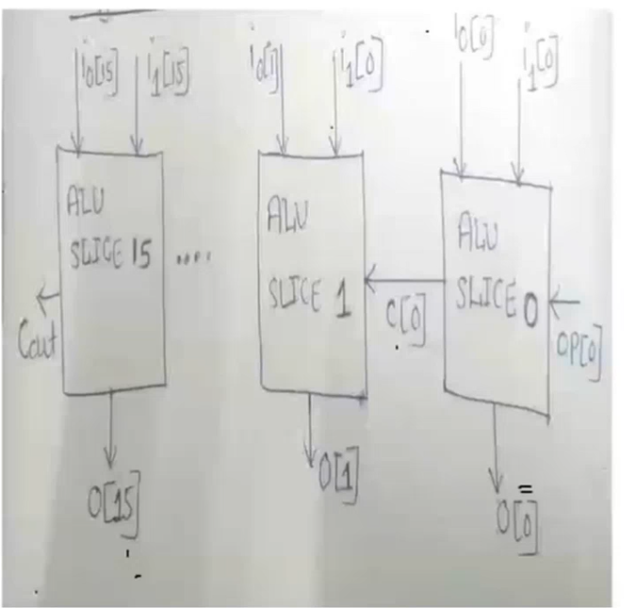

Slide 13
module alu (input wire [1:0] op, input wire [15:0] i0, i1, output wire [15:0] o, output wire cout);
wire [14:0] c;
alu_slice _i0 (--------------------);
alu_slice _i1 (--------------------);
alu_slice _i2 (-------------------);
alu_slice _i3 (-----------------------);
alu_slice _i4 (----------------------);
alu_slice _i5 (----------------------);
alu_slice _i6 (------------------------);
alu_slice _i7 (-----------------------);
alu_slice _i8 (-------------------------);
alu_slice _i9 (------------------------);
alu_slice _i10 (------------------------);

Slide 14
alu_slice _i11 (------------------------);
alu_slice _i12 (------------------------);
alu_slice _i13 (------------------------);
alu_slice _i14 (------------------------);
alu_slice _i15 (------------------------);
endmodule

Slide 15
Testbench tb_alu.v
`timescale 1 ns / 100 ps
`define TESTVECS 16
module tb;
reg clk, reset;
reg [1:0] op;
reg [15:0] i0, i1;
wire [15:0] o;
wire cout;
reg [33:0]
test_vecs [0:(`TESTVECS-1)];
integer i;
initial
begin

Slide 16
$dumpfile("tb_alu.vcd");
$dumpvars(0,tb);
end
initial
begin
reset = 1'b1;
#12.5
reset = 1'b0;
end
initial clk = 1'b0;
always
#5
clk =~ clk;
initial
begin

Slide 17
test_vecs[0][33:32] = 2'b00;
test_vecs[0][31:16] = 16'h0000;
test_vecs[0][15:0] = 16'h0000;
test_vecs[1][33:32] = 2'b00;
test_vecs[1][31:16] = 16'haa55;
test_vecs[1][15:0] = 16'h55aa;
test_vecs[2][33:32] = 2'b00;
test_vecs[2][31:16] = 16'hffff;
test_vecs[2][15:0] = 16'h0001;
test_vecs[3][33:32] = 2'b00;
test_vecs[3][31:16] = 16'h0001;
test_vecs[3][15:0] = 16'h7fff;
test_vecs[4][33:32] = 2'b01;
test_vecs[4][31:16] = 16'h0000;
test_vecs[4][15:0] = 16'h0000;

Slide 18
test_vecs[5][33:32] = 2'b01;
test_vecs[5][31:16] = 16'haa55;
test_vecs[5][15:0] = 16'h55aa;
test_vecs[6][33:32] = 2'b01;
test_vecs[6][31:16] = 16'hffff;
test_vecs[6][15:0] = 16'h0001;
test_vecs[7][33:32] = 2'b01;
test_vecs[7][31:16] = 16'h0001;
test_vecs[7][15:0] = 16'h7fff;
test_vecs[8][33:32] = 2'b10;
test_vecs[8][31:16] = 16'h0000;
test_vecs[8][15:0] = 16'h0000;
test_vecs[9][33:32] = 2'b10;
test_vecs[9][31:16] = 16'haa55;
test_vecs[9][15:0] = 16'h55aa;
;

Slide 19
test_vecs[10][33:32] = 2'b10;
test_vecs[10][31:16] = 16'hffff
test_vecs[10][15:0] = 16'h0001; test_vecs[11][33:32] = 2'b10;
test_vecs[11][31:16] = 16'h0001;
test_vecs[11][15:0] = 16'h7fff;
test_vecs[12][33:32] = 2'b11;
test_vecs[12][31:16] = 16'h0000;
test_vecs[12][15:0] = 16'h0000; test_vecs[13][33:32] = 2'b11;
test_vecs[13][31:16] = 16'haa55;
test_vecs[13][15:0] = 16'h55aa; test_vecs[14][33:32] = 2'b11;
test_vecs[14][31:16] = 16'hffff;
test_vecs[14][15:0] = 16'h0001;

Slide 20
test_vecs[15][33:32] = 2'b11;
test_vecs[15][31:16] = 16'h0001;
test_vecs[15][15:0] = 16'h7fff;
end initial {op, i0, i1} = 0;
alu alu_0 (op, i0, i1, o, cout);
initial begin
#6
for(i=0;i<`TESTVECS ; i=i+1)
begin
#10
{op, i0, i1}=test_vecs[i];
end #100 $finish;
end
endmodule

Slide 21
DESIGN AND SIMULATION
To simulate the ALU with the test vectors, run the commands: iverilog -o tb_alu lib.v alu.v tb_alu.v
vvp tb_alu
Above commands should produce the tb_alu.vcd file.
To view the waveforms, run the command: gtkwave tb_alu.vcd

Slide 22
 | op[1:0] | i0[15:0] | i1[15:0] | Output
TESTVECTOR1 | 2’b00 | 16’h0000 | 16’h0000
TESTVECTOR2 | 2’b00 | 16’haa55 | 16’h55aa
TESTVECTOR3 | 2’b00 | 16'hffff | 16'h0001
TESTVECTOR3 | 2’b00 | 16'h0001 | 16'h7fff
TESTVECTOR4 | 2'b01 | 16'h0000 | 16'h0000
TESTVECTOR5 | 2'b01 | 16'haa55 | 16'h55aa
TESTVECTOR6 | 2'b01 | 16'hffff | 16'h0001;
TESTVECTOR7 | 2'b01 | 16‘h0001 | 16'h7fff;

Slide 23
 | op[1:0] | i0[15:0] | i1[15:0] | Output
TESTVECTOR8 | 2’b10 | 16’h0000 | 16’h0000
TESTVECTOR9 | 2’b10 | 16’haa55 | 16’h55aa
TESTVECTOR10 | 2’b10 | 16'hffff | 16'h0001
TESTVECTOR11 | 2’b10 | 16'h0001 | 16'h7fff
TESTVECTOR 12 | 2'b11 | 16'h0000 | 16'h0000
TESTVECTOR 13 | 2'b11 | 16'haa55 | 16'h55aa
TESTVECTOR 14 | 2'b11 | 16'hffff | 16'h0001;
TESTVECTOR 15 | 2'b11 | 16‘h0001 | 16'h7fff;

